Slide 1
Day 2
Distance Sampling
Statistical Methods for Estimating
Abundance in Ecology
Jason Carlisle – WEST, Inc.
Virtual Workshop Sponsored by Wyoming EPSCoR
12/1/2021

Slide 2
Outline of Topics
Distance Sampling in General
Crash Course in Hierarchical Models
The Hierarchical Distance Sampling (HDS) Model
Example HDS Analysis

Slide 3
1) Distance Sampling in General

Slide 4
Distance Sampling
Method to estimate the abundance (or density) of biological populations that accounts for imperfect detection of individuals
Pop quiz:
Why use it – why not just count things directly?
Why the name?

Slide 5
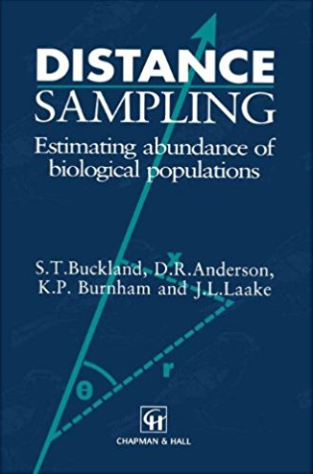
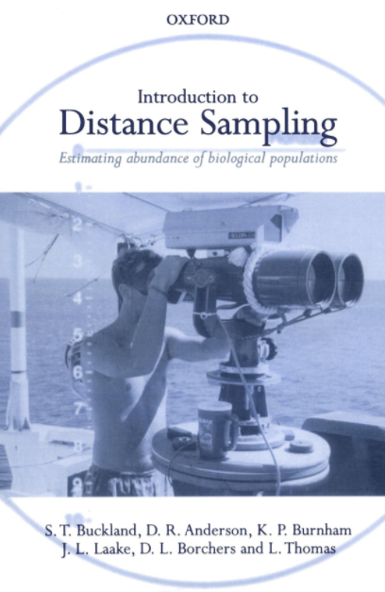
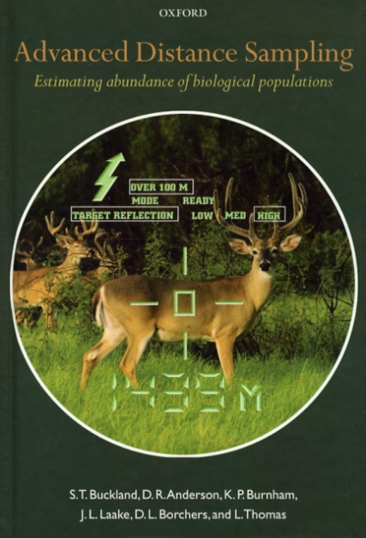
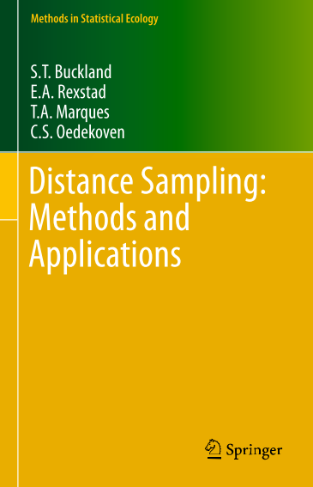
Resources on Distance Sampling
Top recommendation
(Buckland et al. 1993)
(Buckland et al. 2001)
(Buckland et al. 2004)
(Buckland et al. 2015)

Slide 6
How to Estimate Density and Abundance
When probability of detection is 100%
Don’t need distance sampling (or other methods) if the probability of detection (p) = 100%, but this scenario helps one understand how distance sampling accounts for imperfect detection

Slide 7
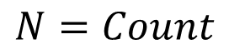
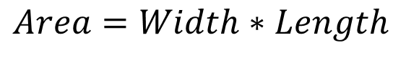
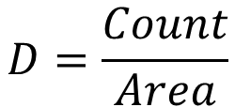
How to Estimate Density and Abundance
When probability of detection is 100%
True abundance (N) is same as observed count
True density (D) is easy to calculate if you know the size of the area surveyed
Area surveyed for (straight) transects is just a rectangle
$$N=Count$$
$$D=\frac{Count}{Area}$$
$$Area=Width∗Length$$

Slide 8
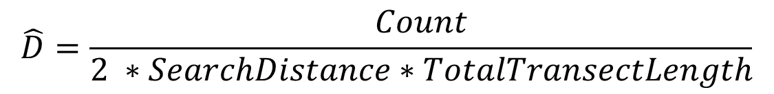
How to Estimate Density and Abundance
When probability of detection is 100%
$$\hat{D}=\frac{Count}{2 ∗SearchDistance∗TotalTransectLength}$$

Slide 9
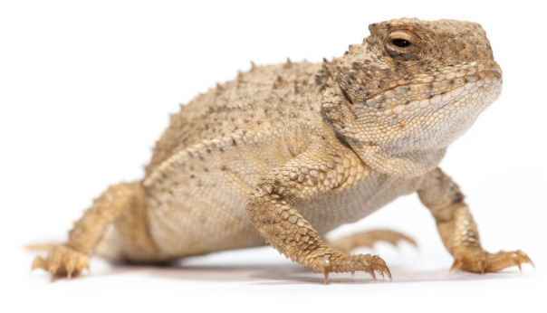
Pop Quiz
When probability of detection is 100%
Assume you surveyed 5 m on both sides of 100 transects that were each 1,000 m long, and you counted 250 lizards.
Assume p = 100%
What is the estimated density of horned lizards per hectare (ha)?
Hint: 1 ha = 10,000 m²

Slide 10
Answer?
When probability of detection is 100%

Slide 11
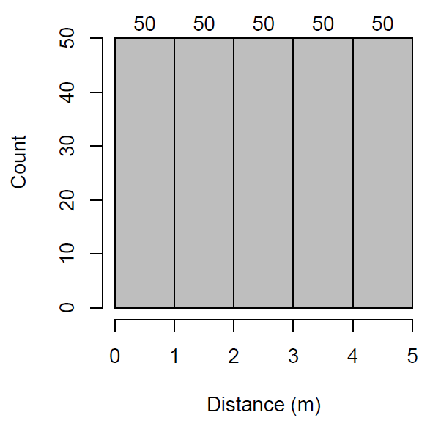
Segue
If p =100%, under the assumptions of line transect sampling (i.e., random placement of transects), we would obtain (on average) a distance histogram like this:
Bars same height
The 250 lizards counted were distributed equally across distance bins
Pop quiz: what distance is being measured here?

Slide 12
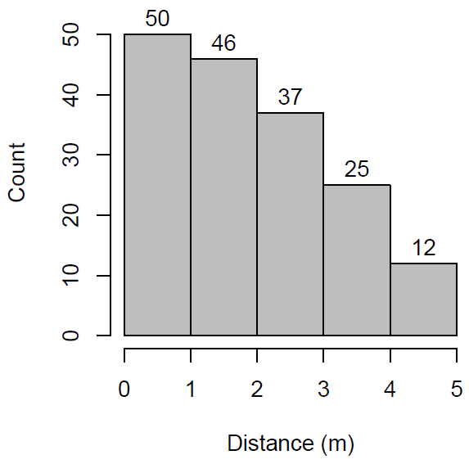
Segue
But what if you repeated the same survey, but now only counted 170 lizards, and your histogram looked like this?

Slide 13
Segue
But what if you repeated the same survey, but now only counted 170 lizards, and your histogram looked like this?
Lower counts at farther distances is a sign that p < 100%
Specifically that detectability decreases as distance increases

Slide 14
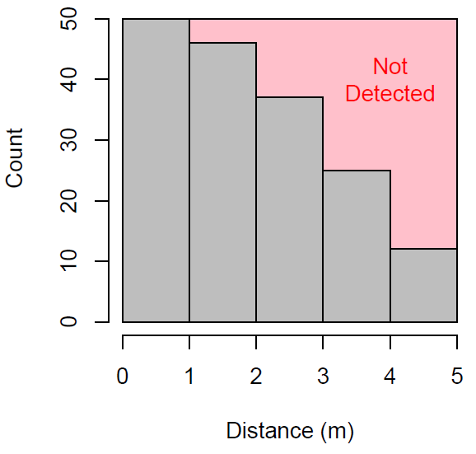
Segue
Some proportion of lizards were not detected
But what proportion?

Slide 15
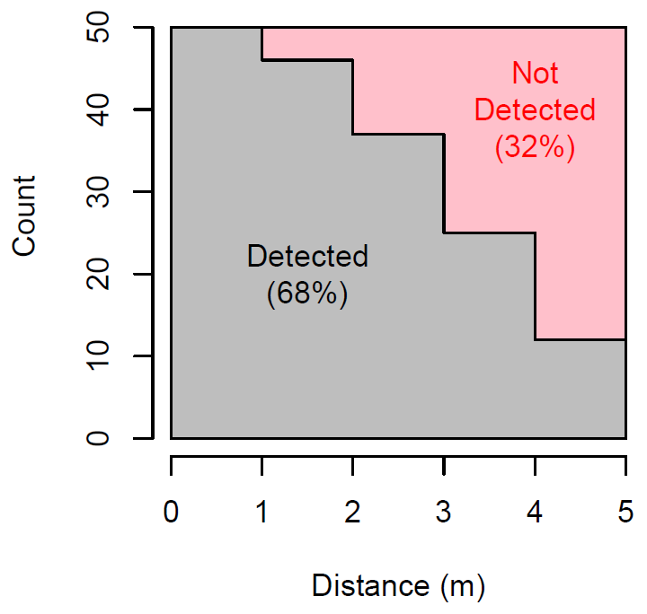
Segue
Some proportion of lizards were not detected
But what proportion?
We know true N is 250
We counted 170
170/250 = 68% detected
1 – 0.68 = 32% missed

Slide 16
How to Estimate Density and Abundance
When probability of detection < 100%
Need distance sampling (or other method) to account for imperfect detection when estimating density or abundance

Slide 17
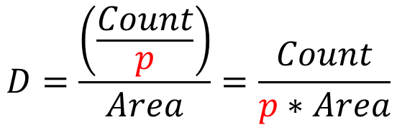
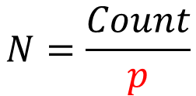
How to Estimate Density and Abundance
When probability of detection < 100%
True abundance (N) estimated as
True density (D) is easy to calculate if you know the size of the area surveyed
Area surveyed for (straight) transects is just a rectangle
$$N=\frac{Count}{p}$$
$$D=\frac{\left(\frac{Count}{p}\right)}{Area}=\frac{Count}{p∗Area}$$
$$Area=Width∗Length$$

Slide 18
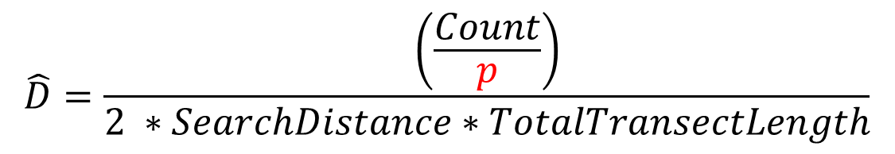
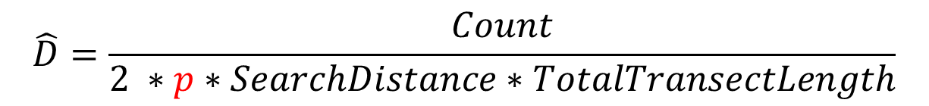
How to Estimate Density and Abundance
When probability of detection < 100%
$$\hat{D}=\frac{\left(\frac{Count}{p}\right)}{2 ∗SearchDistance∗TotalTransectLength}$$
equivalent to
$$\hat{D}=\frac{Count}{2 ∗p∗SearchDistance∗TotalTransectLength}$$

Slide 19
Pop Quiz
When probability of detection < 100%
Assume you surveyed 5 m on both sides of 100 transects that were each 1,000 m long, and you counted 170 lizards.
Assume p = 68%
What is the estimated density of horned lizards per hectare?

Slide 20
Answer?
When probability of detection < 100%

Slide 21
Summary
The shape of the distance histogram is used to estimate the probability of detection
Typically, we fit a model to describe the shape (i.e., the detection function)

Slide 22
2) Crash Course in Hierarchical Models

Slide 23
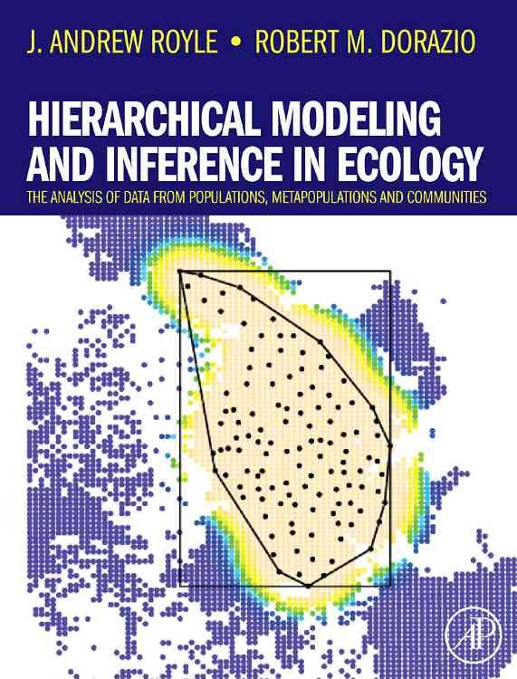


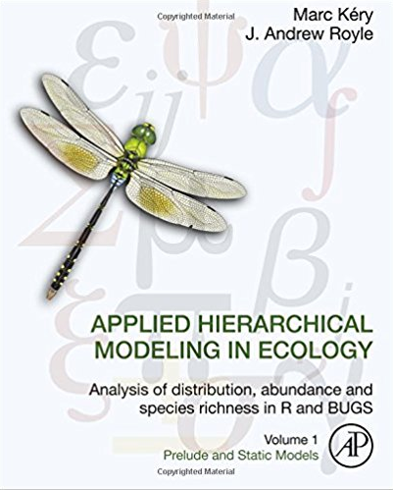
Resources on Hierarchical Models
Top recommendation
(Royle and Dorazio 2008)
(Kéry 2010)
(Kéry and Schaub 2012)
(Kéry and Royle 2016)

Slide 24
Hierarchical Models, Defined
A sequence of probability models that are ordered by their conditional probability structure
i.e., they describe conditionally dependent random variables
Describe the true state of nature that is not observable (or only partly so) and also describe the measurement error
Abundance
Detection
(Kéry and Schaub 2012, Kéry and Royle 2016)

Slide 25
Ecology and Hierarchical Models
Ecology is primarily concerned with ecological states
e.g., abundance (N)
Describing ecological states (or why they change in space or time) is central to ecological research and natural resource management
N
(adapted from Kéry and Schaub 2012)

Slide 26
ecological process
N is the result of an ecological process
N
state of interest

Slide 27
ecological process
N is the result of an ecological process
N
state of interest
Problem:
N is not directly observable
(N is latent)

Slide 28
ecological process
N is the result of an ecological process
N
state of interest
observation process
Solution:
Try to observe N anyways, resulting in counts (C)
C ≠ N
C
imperfect observation of state of interest

Slide 29
ecological process
N is the result of an ecological process
N
state of interest
observation process
C is the result of an ecological process AND
an error-prone observational process
C
imperfect observation of state of interest

Slide 30
Ecologists need the following to make inference on N, when all they really have is C
Special data collection designs
Special models
(Kéry and Schaub 2012)

Slide 31
Ecologists need the following to make inference on N, when all they really have is C
Special data collection designs → recording the distance to each individual in C (aka distance-sampling)
Special models → a hierarchical model that accounts for the two processes that gave rise to C: ecological and observational
(Kéry and Schaub 2012)

Slide 32
3) The Hierarchical Distance Sampling Model

Slide 33
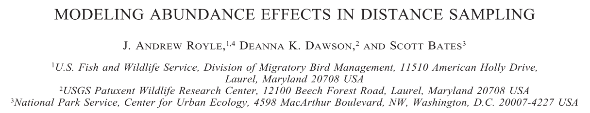

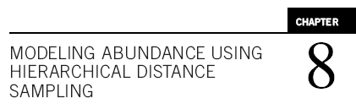
Resources on Hierarchical Distance Sampling
Seminal paper: Royle et al. 2004
Thorough coverage: Ch. 8 in Kéry and Royle 2016

Slide 34
Hierarchical Distance Sampling (HDS)
One type of multinomial N-mixture model
Straightforward to implement in R package unmarked
Session | Model | Detection Process | Abundance Process | unmarked Function
1 | (Binomial) N-Mixture | Binomial | Poisson (or other) | pcount
2 | Distance Sampling | Multinomial | Poisson (or other) | distsamp
(Royle et al. 2004, Fiske and Chandler 2011)

Slide 35
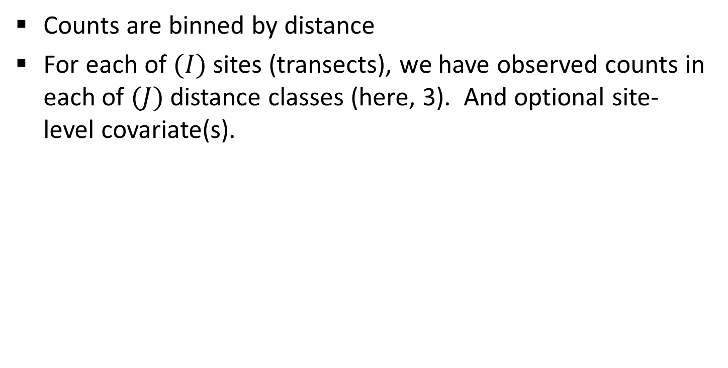
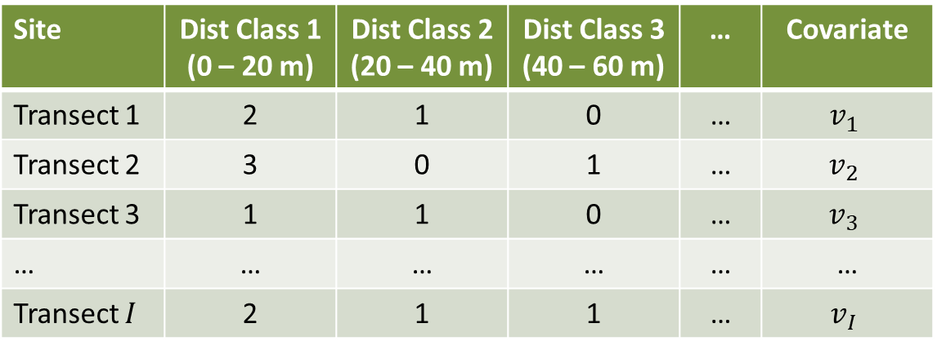
HDS Data Structure
Counts are binned by distance
For each of $(I)$ sites (transects), we have observed counts in each of $(J)$ distance classes (here, 3). And optional site-level covariate(s).
Site | Dist Class 1 (0 – 20 m) | Dist Class 2 (20 – 40 m) | Dist Class 3 (40 – 60 m) | … | Covariate
Transect 1 | 2 | 1 | 0 | … | $$v_{1}$$
Transect 2 | 3 | 0 | 1 | … | $$v_{2}$$
Transect 3 | 1 | 1 | 0 | … | $$v_{3}$$
… | … | … | … | … | …
Transect $I$ | 2 | 1 | 1 | … | $$v_{I}$$

Slide 36
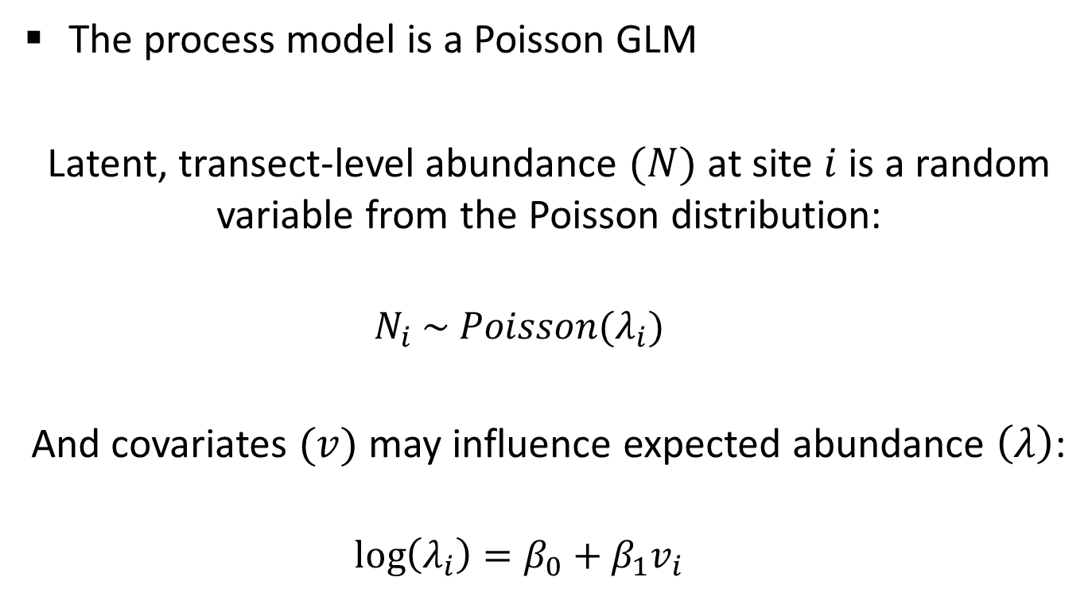
The HDS Process Model (Abundance)
The process model is a Poisson GLM
Latent, transect-level abundance $(N)$ at site $i$ is a random variable from the Poisson distribution:
$$N_{i} \sim Poisson(λ_{i})$$
And covariates $(v)$ may influence expected abundance $\left(λ\right)$:
$$\log\left(λ_{i}\right)=β_{0}+β_{1}v_{i}$$

Slide 37

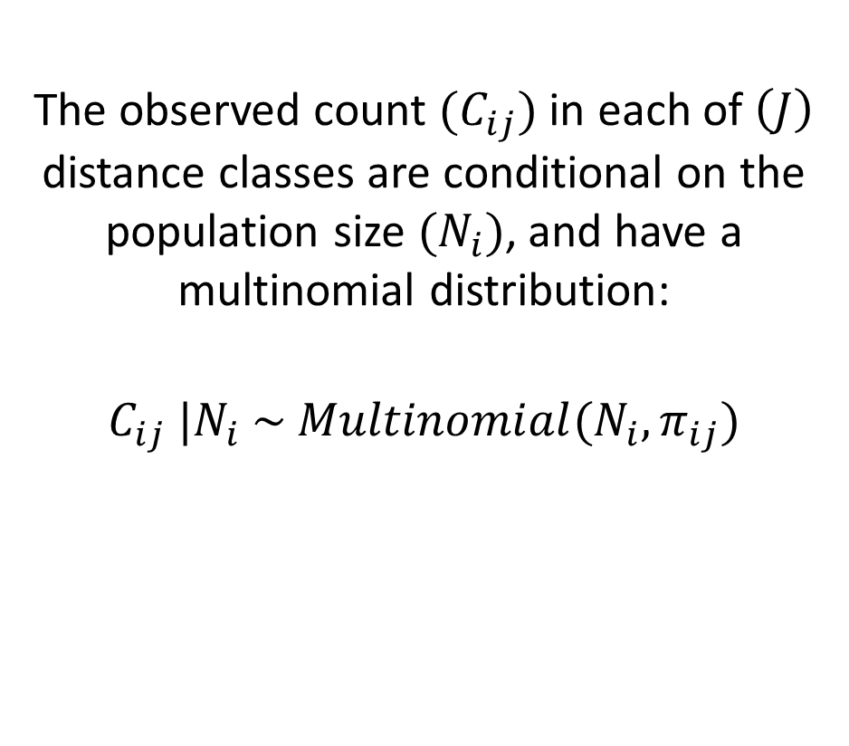
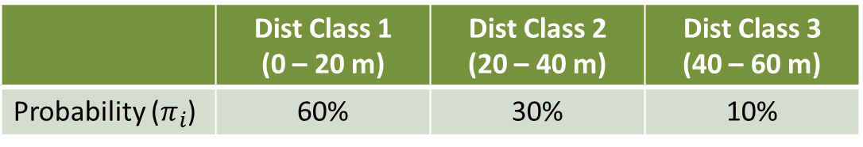
The HDS Observation Model (Detection)
The observed count $(C_{ij})$ in each of $\left(J\right)$ distance classes are conditional on the population size $(N_{i})$, and have a multinomial distribution:
$$C_{ij} |N_{i} \sim Multinomial(N_{i}, π_{ij})$$
 | Dist Class 1 (0 – 20 m) | Dist Class 2 (20 – 40 m) | Dist Class 3 (40 – 60 m)
Probability ($π_{i}$) | 60% | 30% | 10%

Slide 38
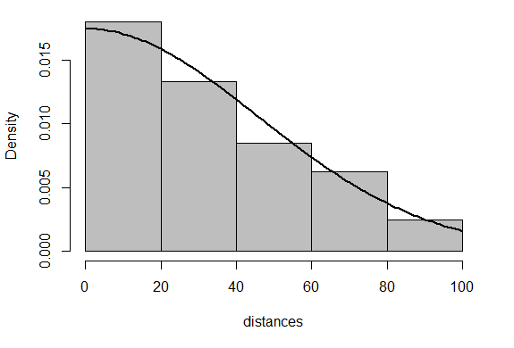
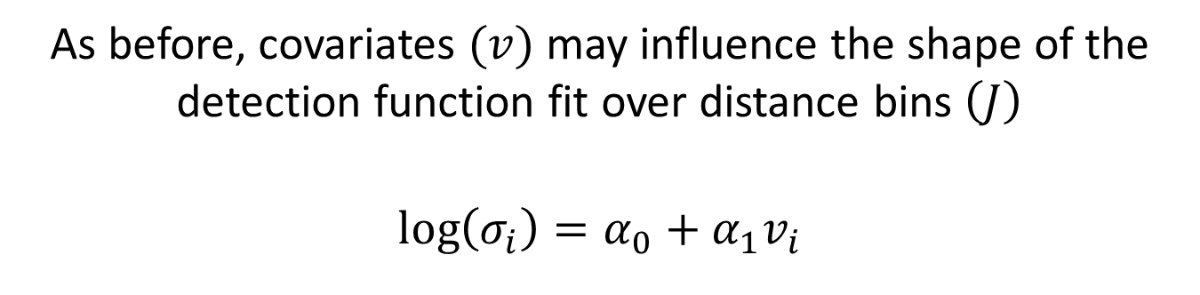
The HDS Observation Model (Detection)
A detection function (here, half-normal) is fit over the bins
As before, covariates $(v)$ may influence the shape of the detection function fit over distance bins $\left(J\right)$
$$\log\left(σ_{i}\right)=α_{0}+α_{1}v_{i}$$

Slide 39
4) Example Hierarchical Distance Sampling Analysis

Slide 40
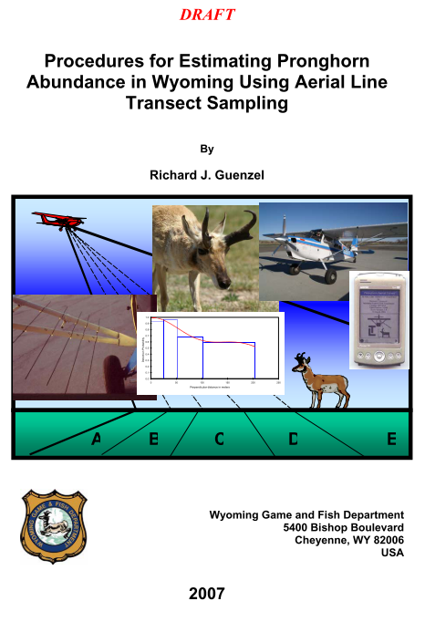
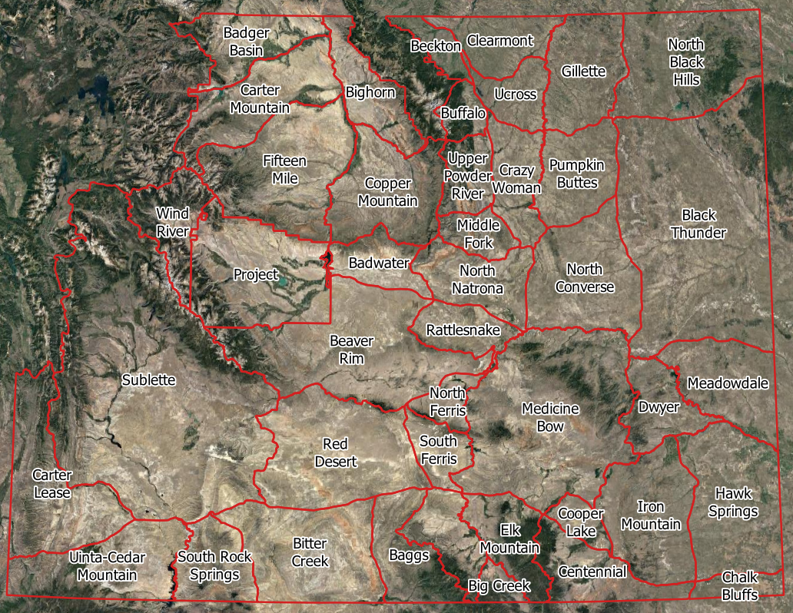
Pronghorn Aerial Line Transect Surveys

Slide 41

Pronghorn Aerial Line Transect Surveys
Systematic sample of North-South transects in each herd unit

Slide 42
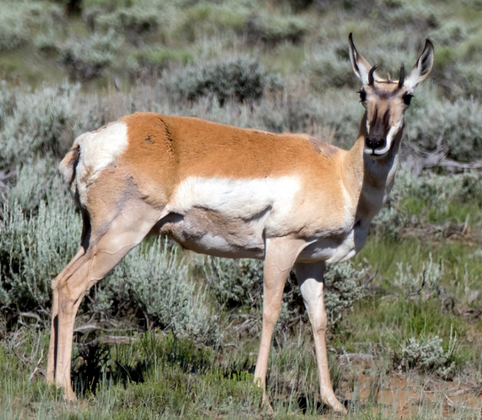
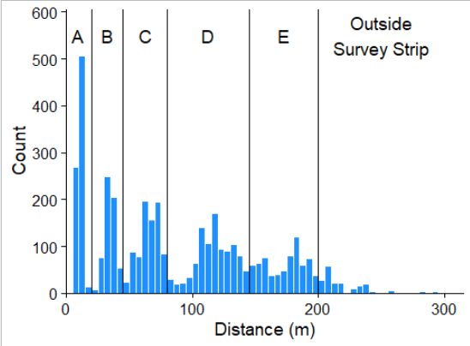
Example Data: Pronghorn
pronghornSiteData
186 sites
Lengths vary (2 – 46 km)
Only 1 side of transect surveyed
1 covariate (herd unit)
pronghornDetectionData
4,110 detected individuals
(Amy Hunt)

Slide 43
Research Question
Which pronghorn herd in southeast Wyoming has the highest population density?
Medicine Bow
Cooper Lake
Centennial

Slide 44

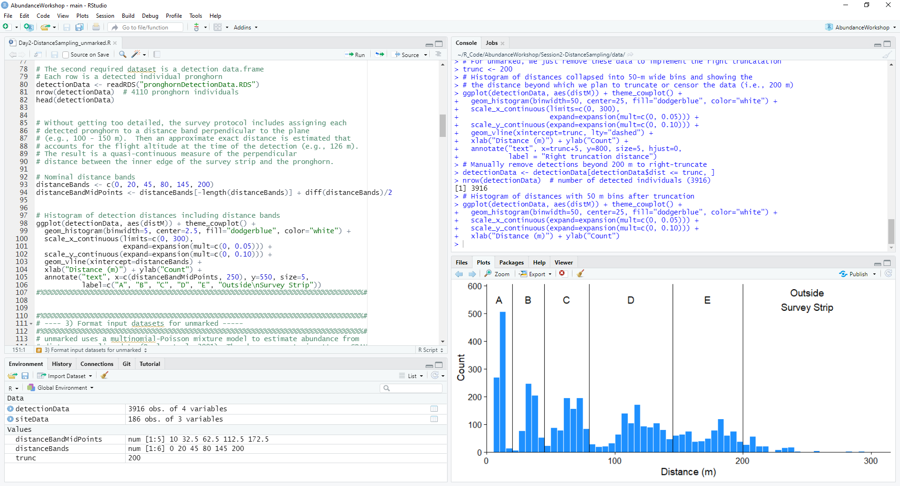
Breakout Rooms: Work through R Script

Slide 45
Questions
What sorts of studies have you seen distance sampling applied to?
What similarities do you see between the N-mixture and distance sampling models?
What differences do you see?
Why does the distance sampling model use the Multinomial distribution to model detection?
Should you include the same covariate in the detection and abundance portions of the model?

